Slide 1

FMT Reversi Android
by
Francesco Benincasa

Slide 2

Roadmap
Intro
The project
Demo
Let’s dive into the code
Conclusions

Slide 3
Introduction
The aim of the project is to realize a Reversi implementation on Android platform:
Match on the same device
Match between two devices (each player on his own device)
The game rules are based on Reversi on Wikipedia and Federazione Nazionale Gioco Othello

Slide 4











The project - what did we use?

Slide 5

The project - modules
Reversi-core
Reversi-android
Reversi-backend

Slide 6
Build process
Android development
Backend development
https://836c360b507d.ngrok.io
https://fmt-reversi.herokuapp.com/

Slide 7
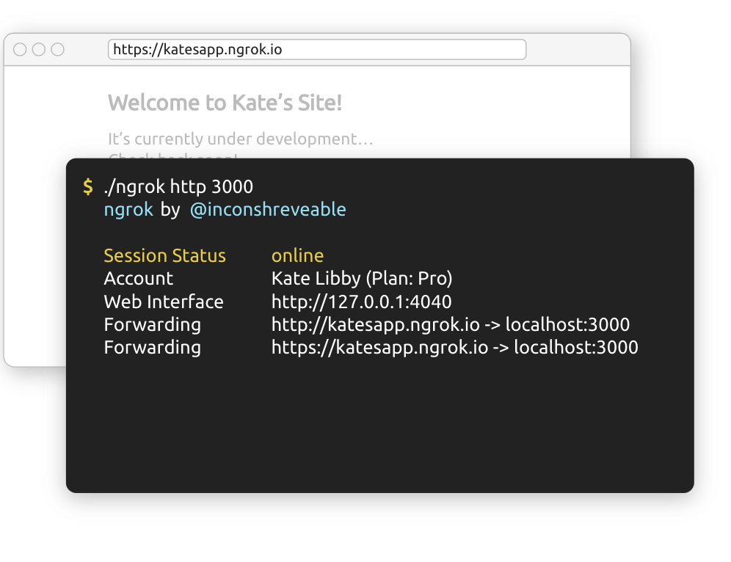
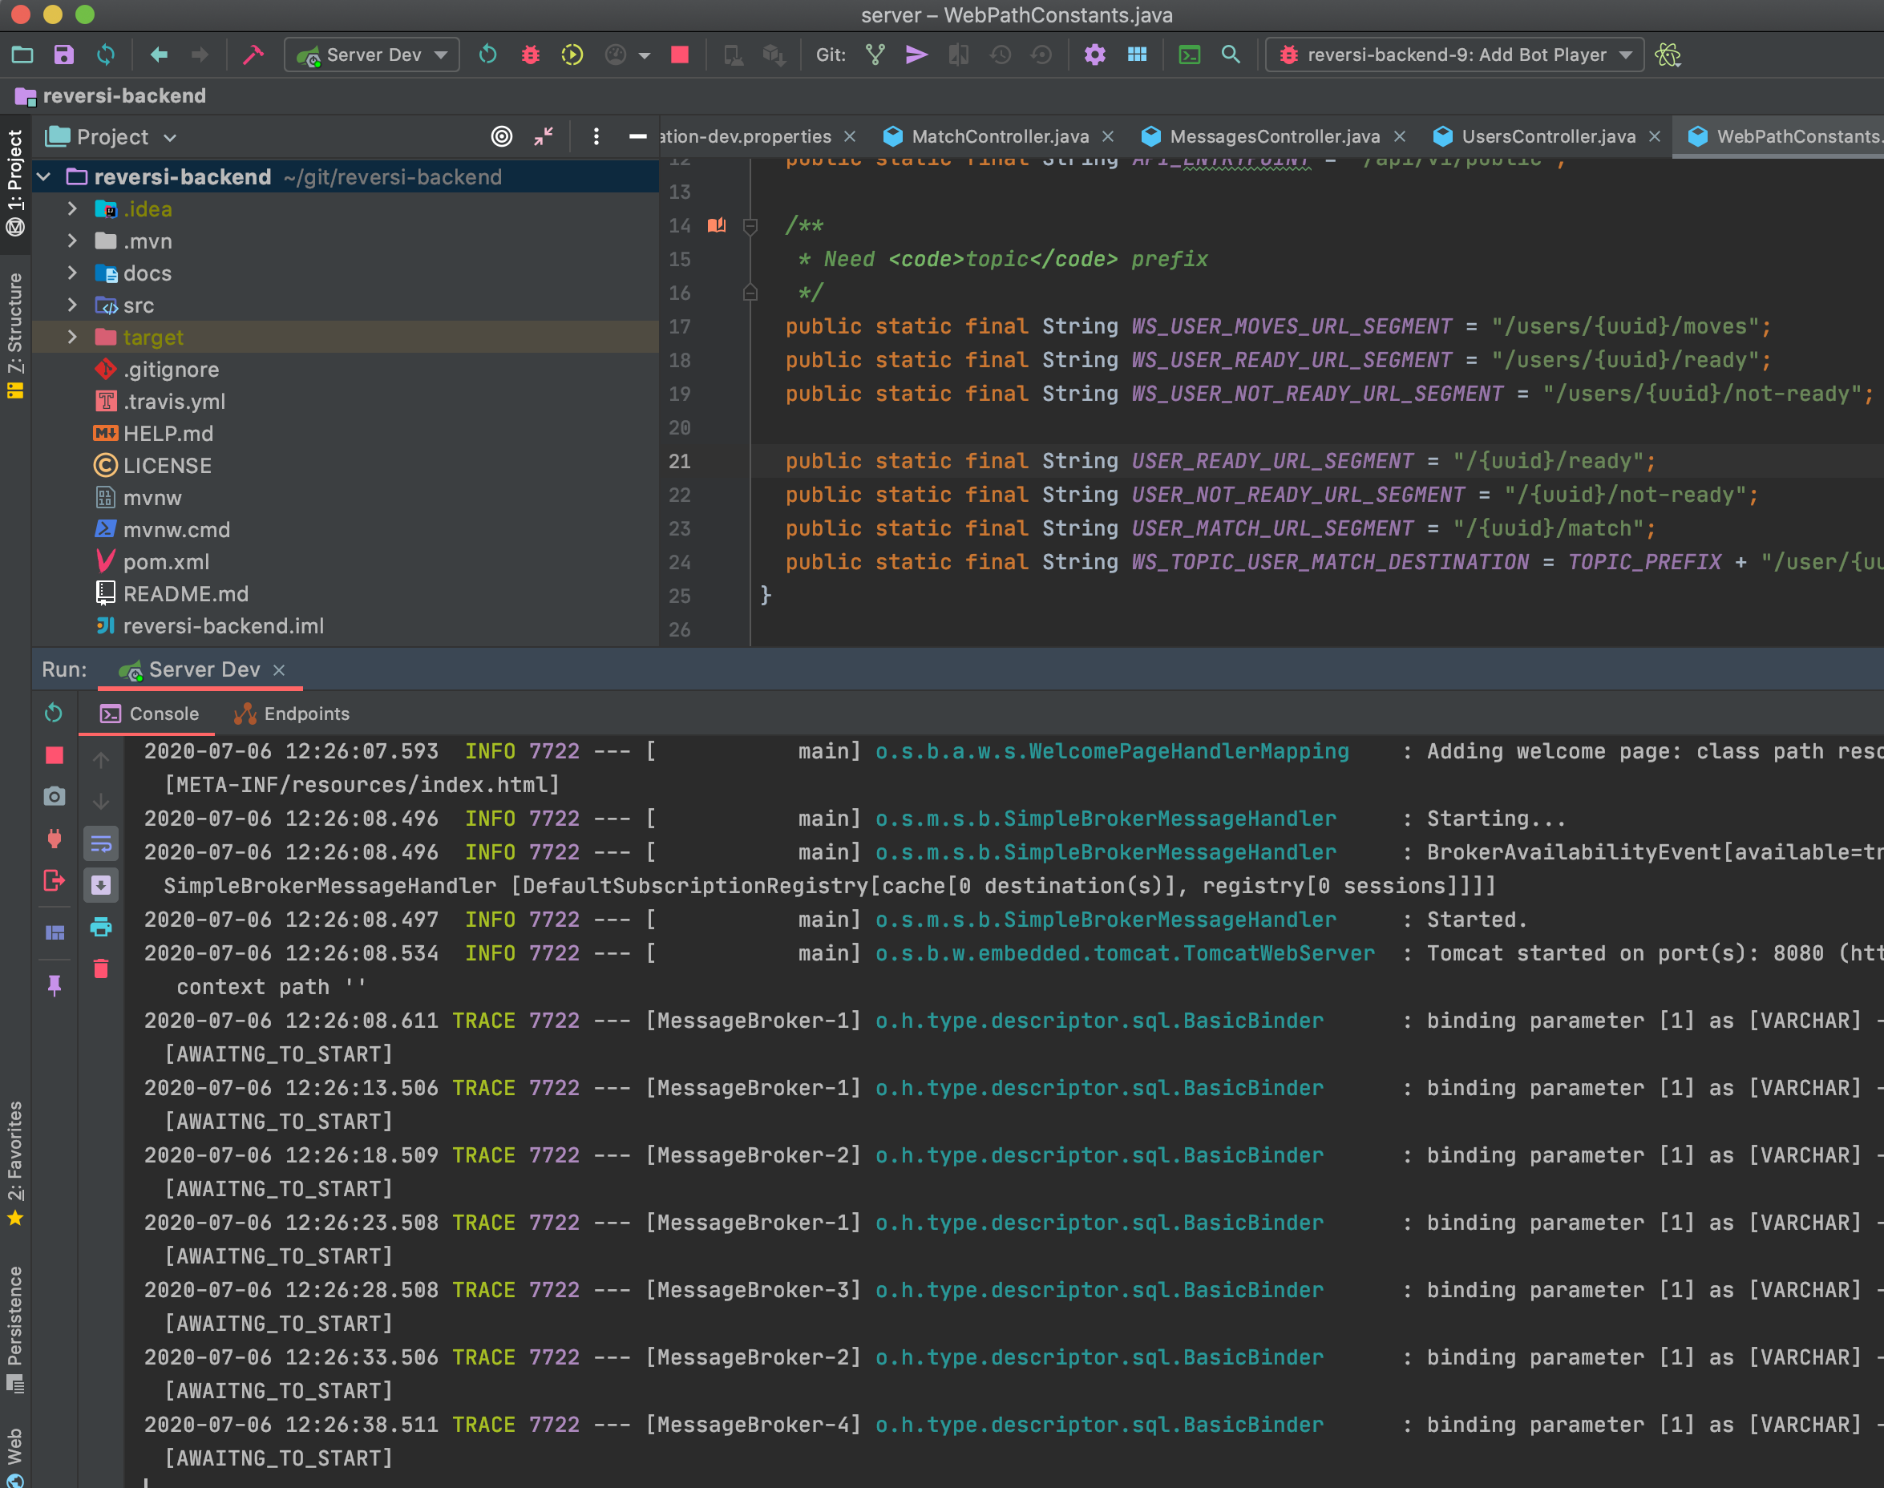
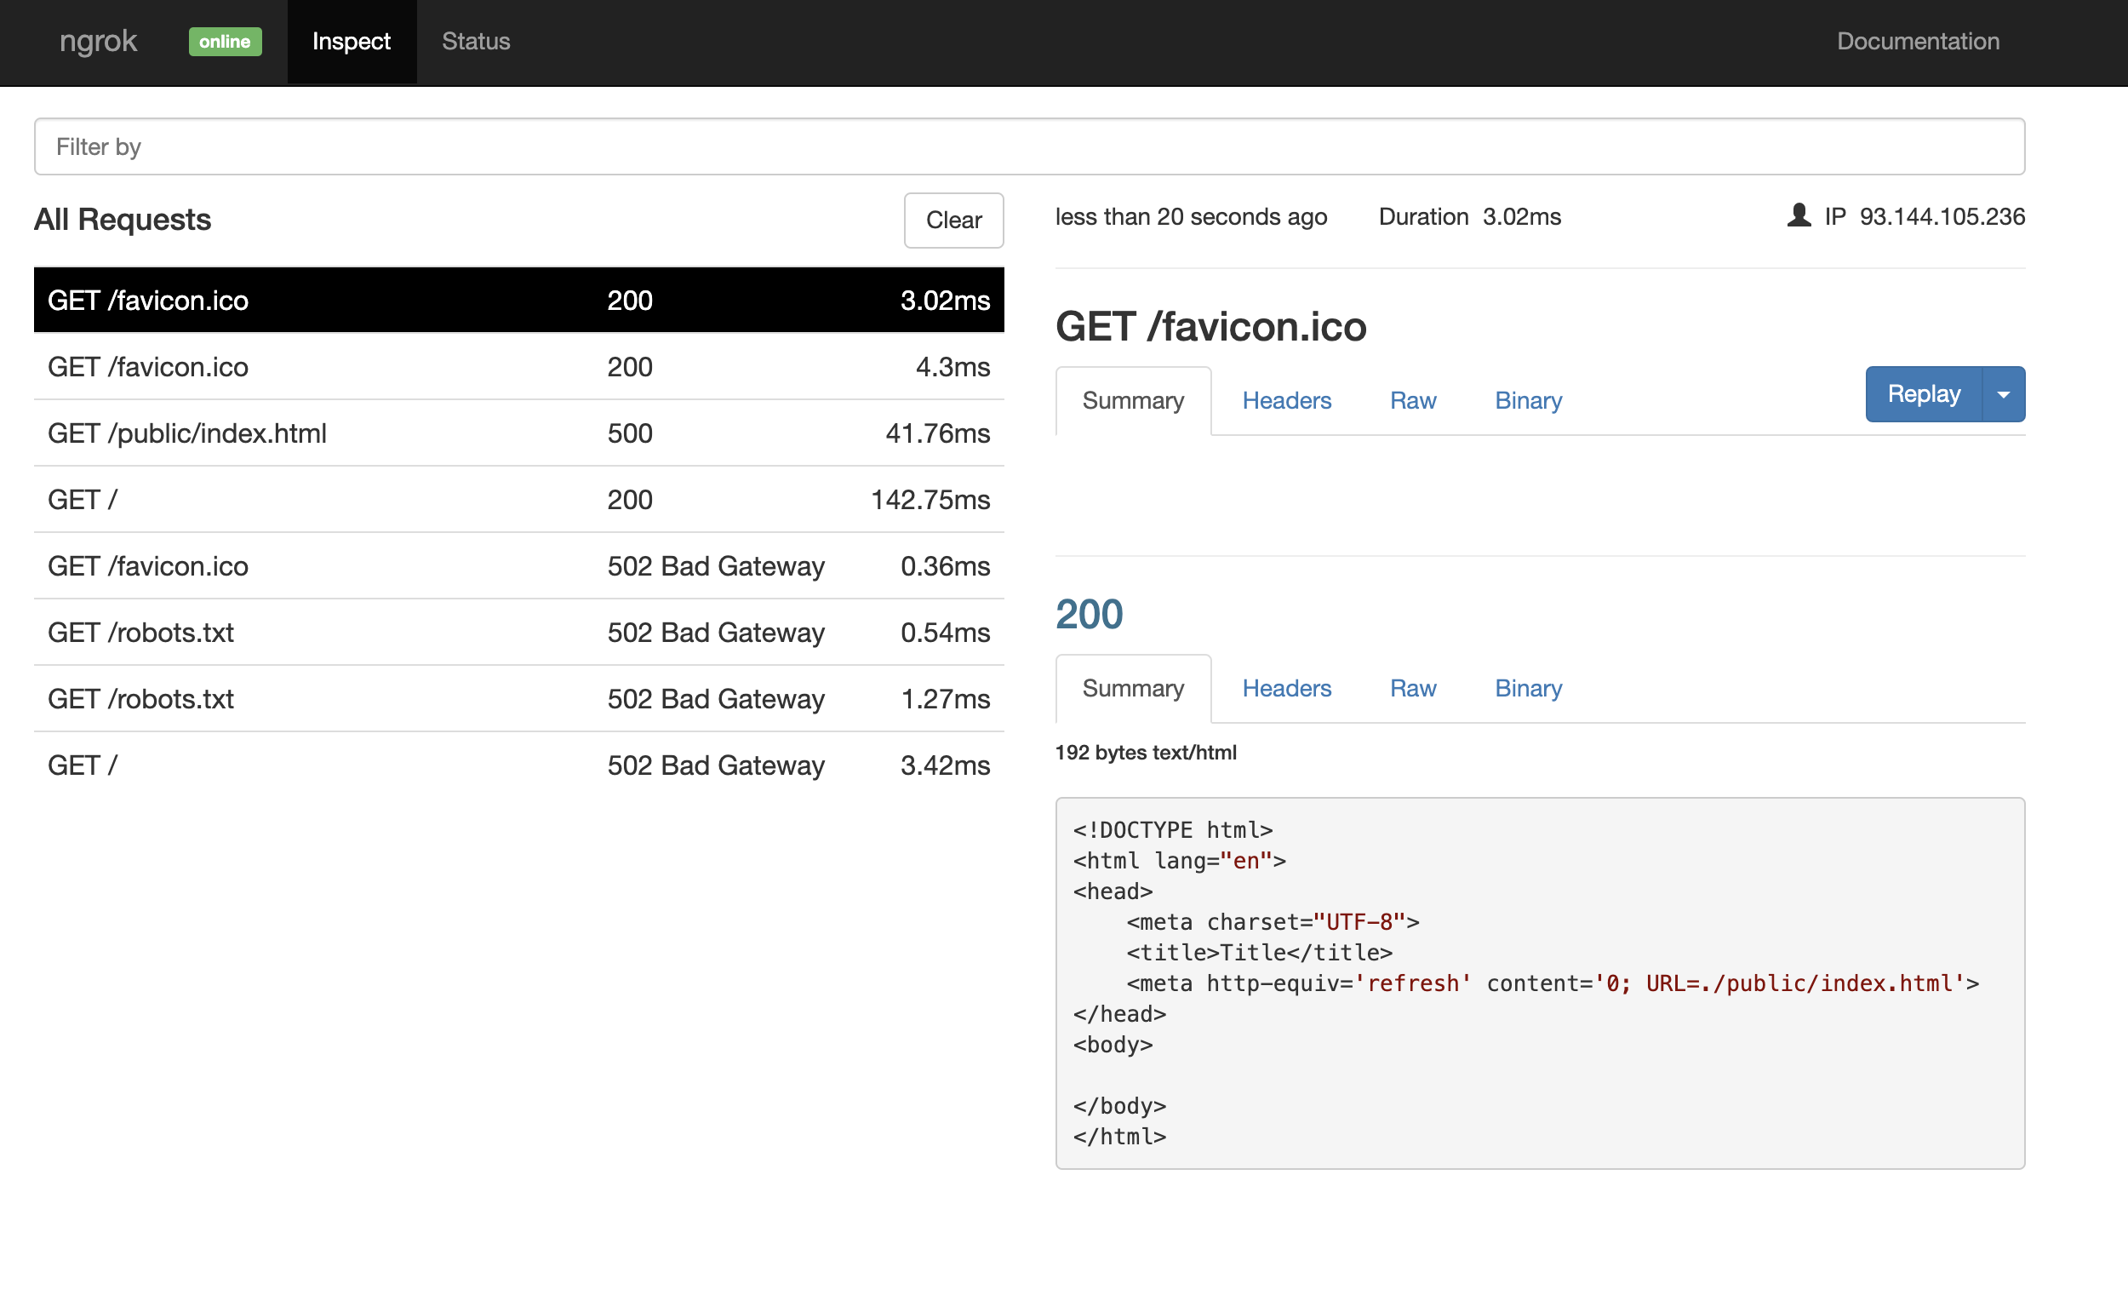
Backend development
NGROK was used to expose local server on the web during development

Slide 8
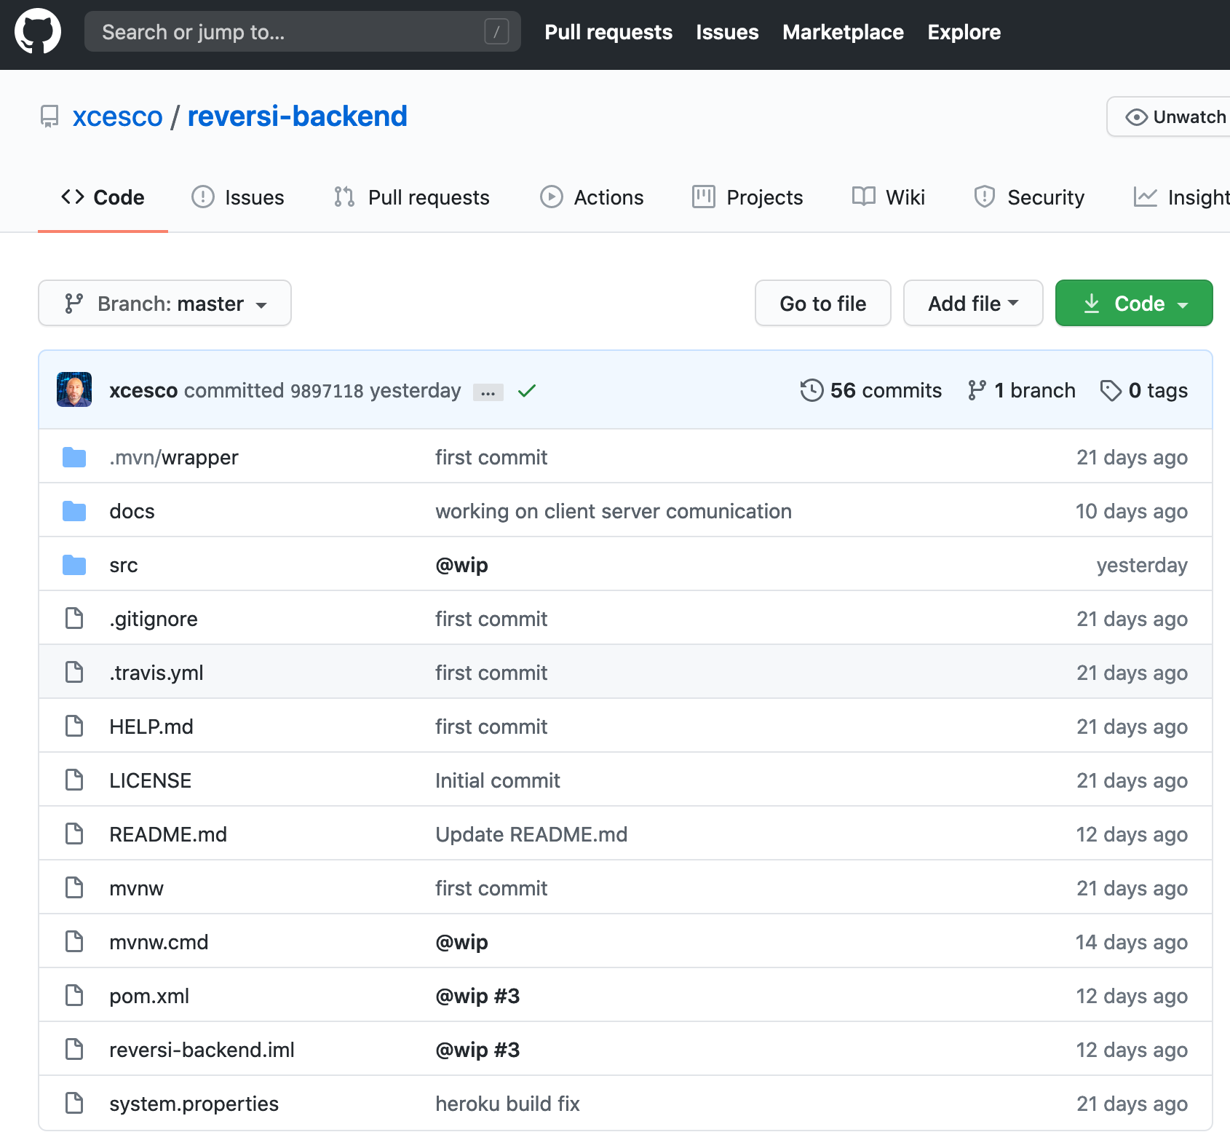
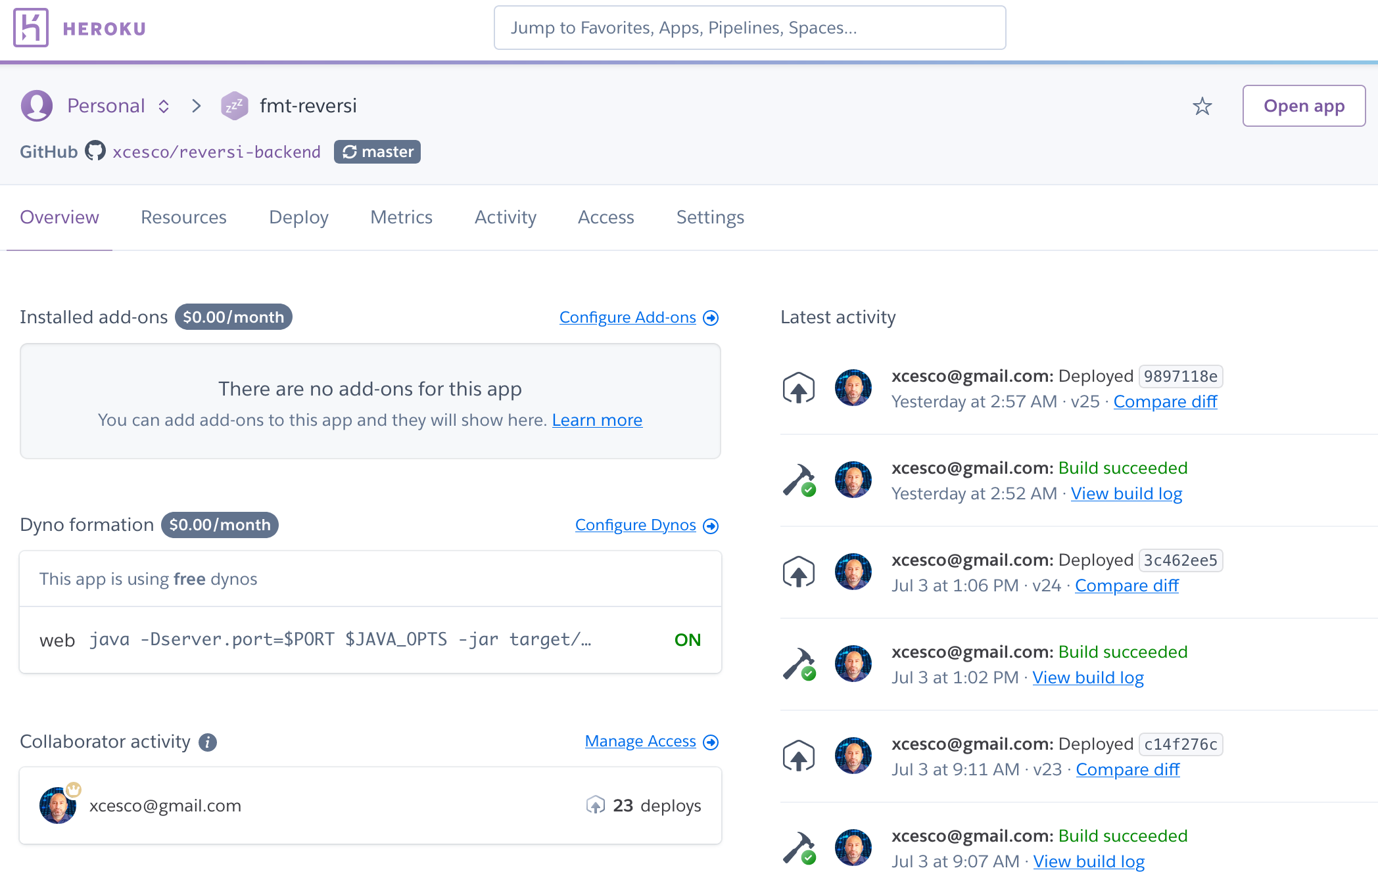
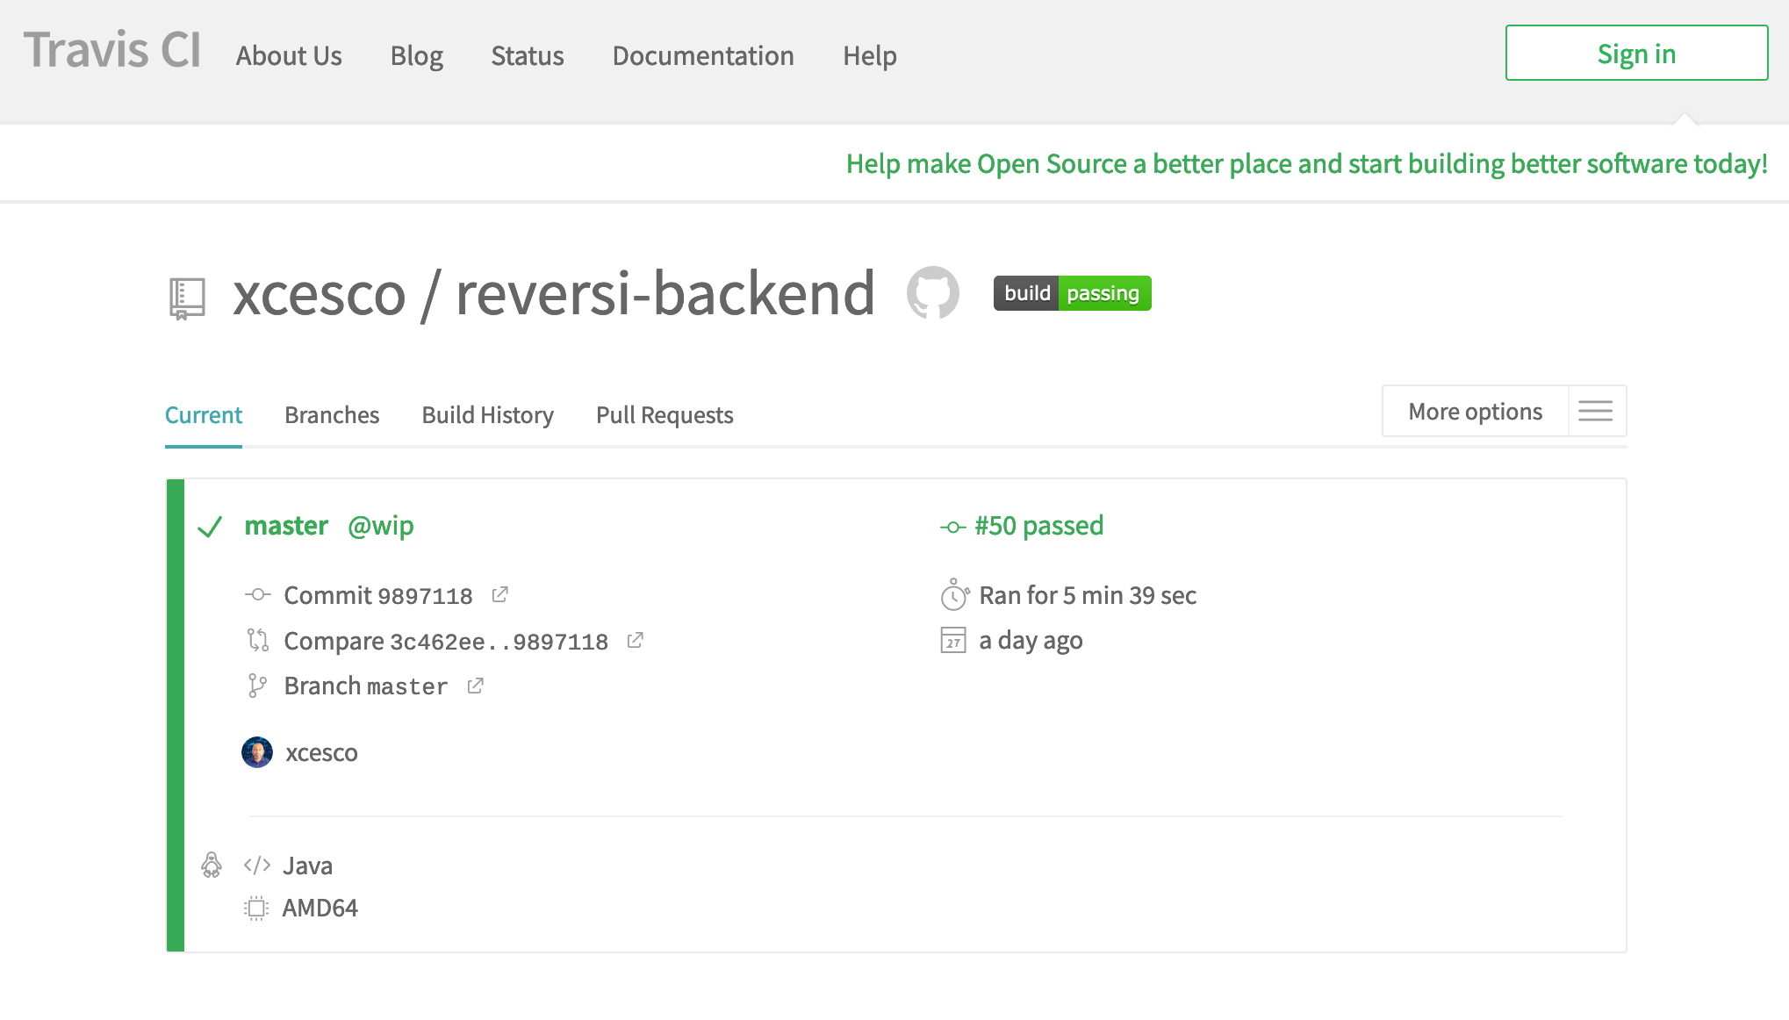
Backend development
To deploy backend server, github, travis and heroku were used

Slide 9
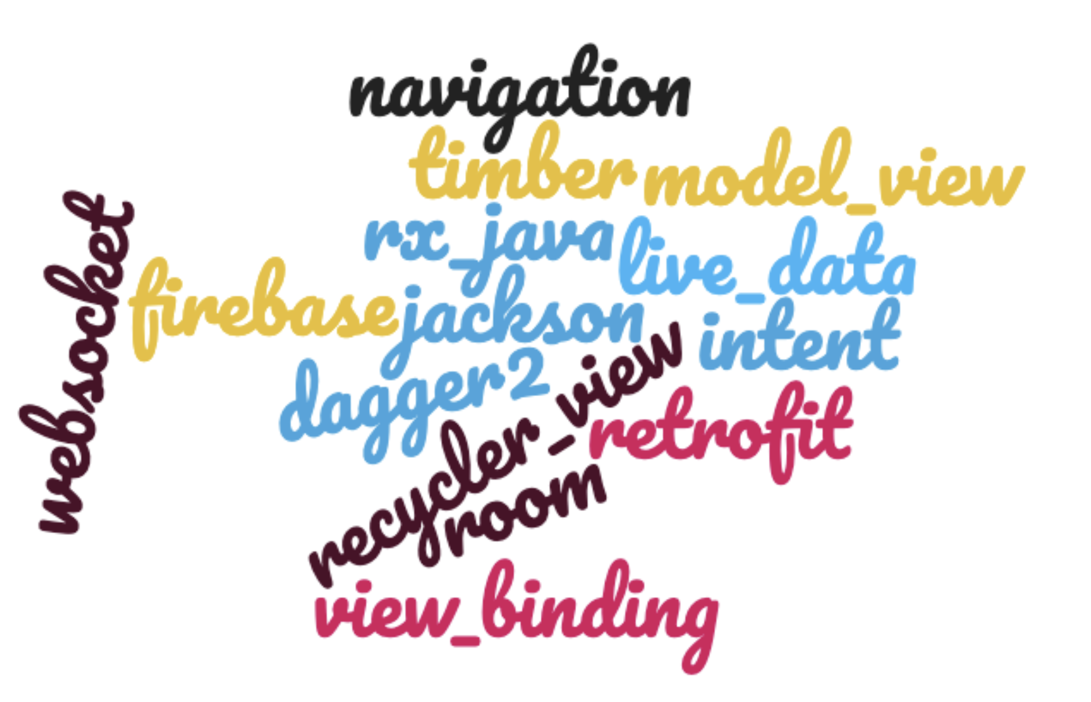
Android development
View model & live data
Shared preferences
Navigation
Intent
Retrofit
Websocket & STOMP
Recycler View
Jackson
RX java
Timber
Firebase
Dagger2
Notes:
model_view
live_data
shared_preference
navigation
intent
retrofit
websocket
view_binding
room
recycler_view
jackson
rx_java
timber
firebase
dagger2

Slide 10
About Android development
Retrofit: https://square.github.io/retrofit/
Okhttp: https://square.github.io/okhttp/
Websocket & STOMP protocol: https://github.com/NaikSoftware/StompProtocolAndroid
Jackson: https://github.com/FasterXML/jackson
ViewBinding: https://developer.android.com/topic/libraries/view-binding#java
Daggger: https://github.com/google/dagger
Navigation component: https://developer.android.com/guide/navigation/navigation-pass-data
ModelView & Live data components: https://developer.android.com/topic/libraries/architecture/livedata
Timber: https://github.com/JakeWharton/timber
Firebase https://firebase.google.com/docs/crashlytics/get-started?authuser=0&platform=android

Slide 11
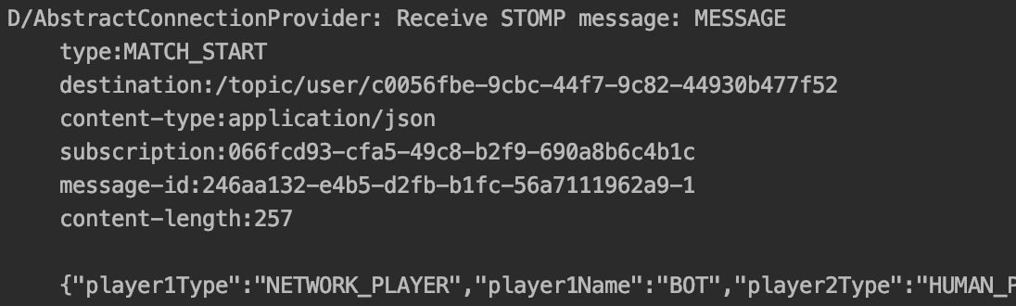
Why WebSocket?
Game server contains match status
Network matches required in some case server start comunication with clients.
The choice was Simple (or Streaming) Text Oriented Message Protocol (STOMP) on WebSocket

Slide 12
Why WebSocket?
Client connects to server with a web service (synchronized request-response)
Client receives an UUID will be used from server to identificate it.
Client subscribe to match topic to receive server comunication.
JSON message, based on STOMP over WebSocket.
Clients send data to server and receive async message from server, until match finish.

Slide 13
Why Live Data and View Model?
Live data and view models allow to manage model changes on UI respecting UI components lifecycle

Slide 14
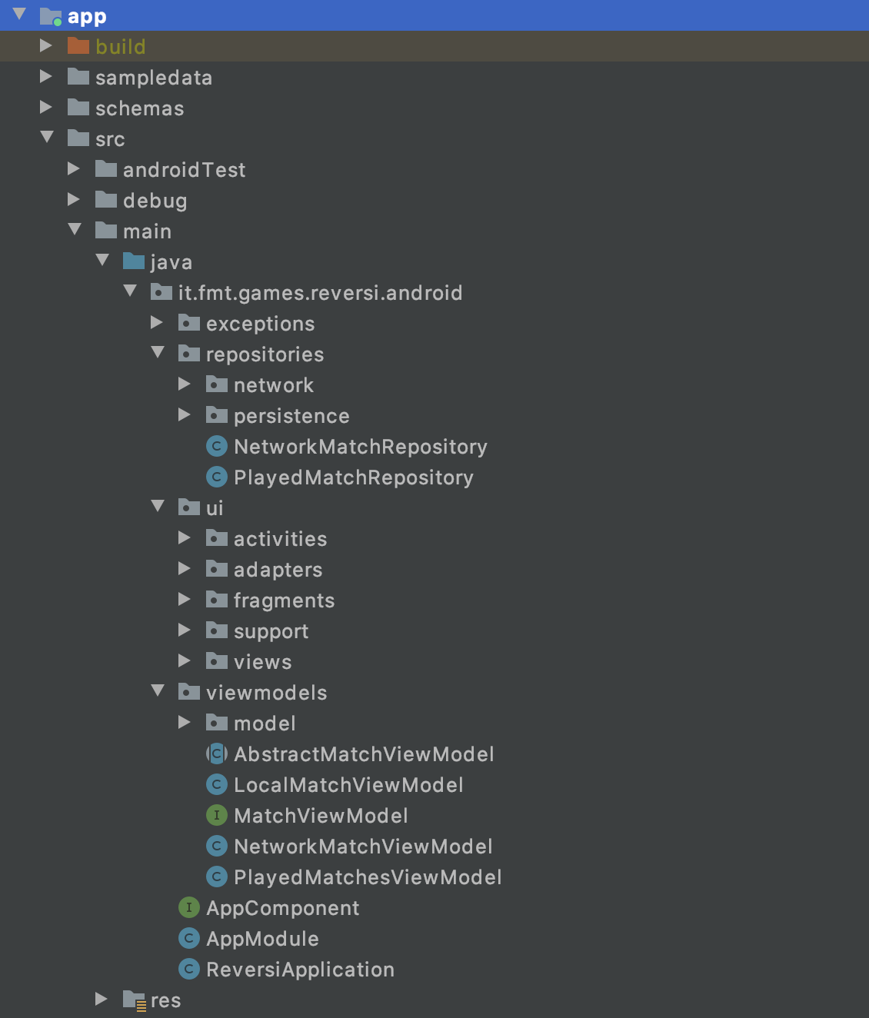
Source code organization
Repositories package
UI (activities, fragment etc)
View models

Slide 15

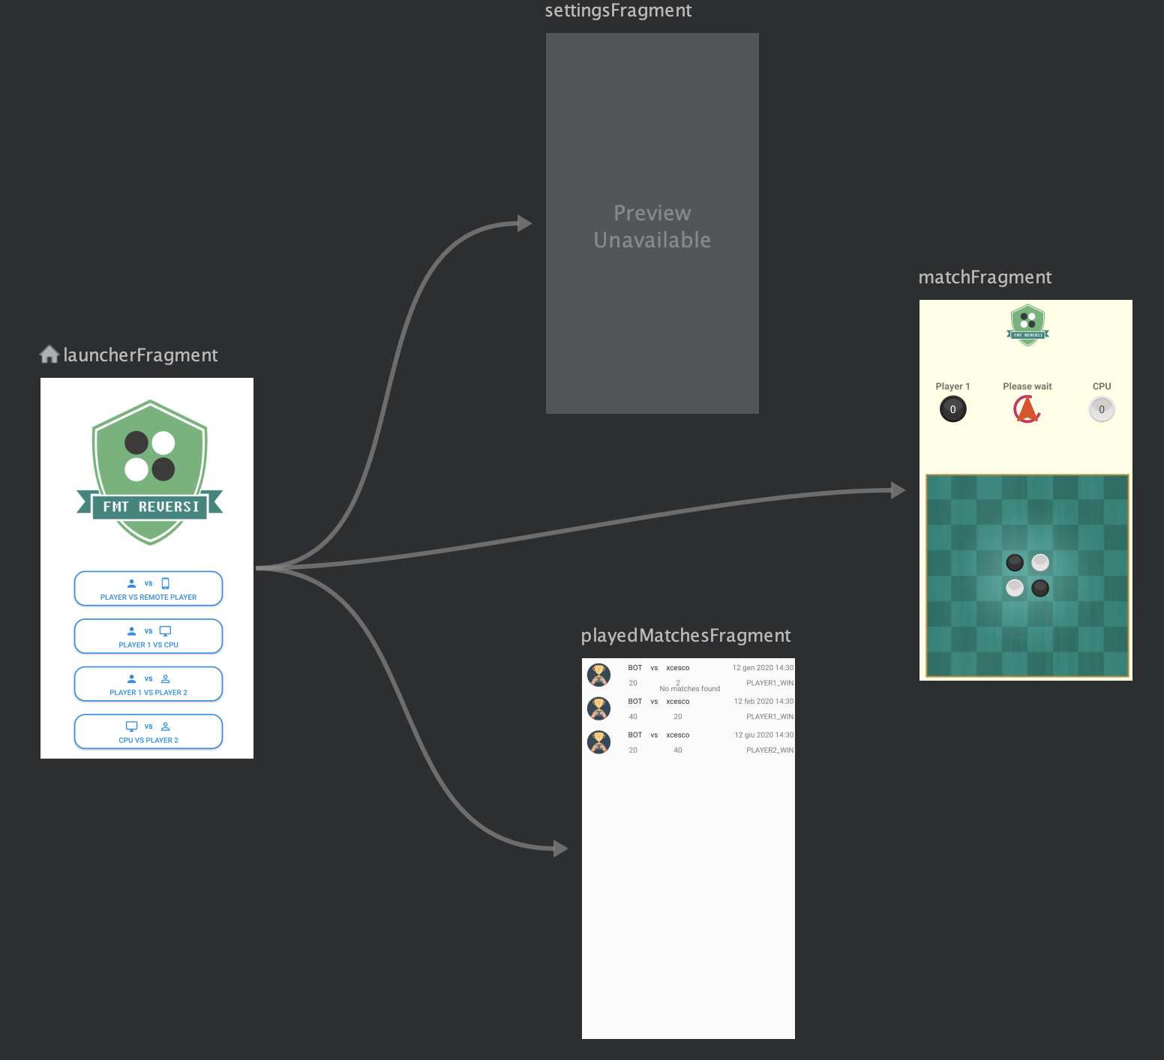
Navigation between fragments
1 activity, 4 fragments, 1 navigation graph

Slide 16
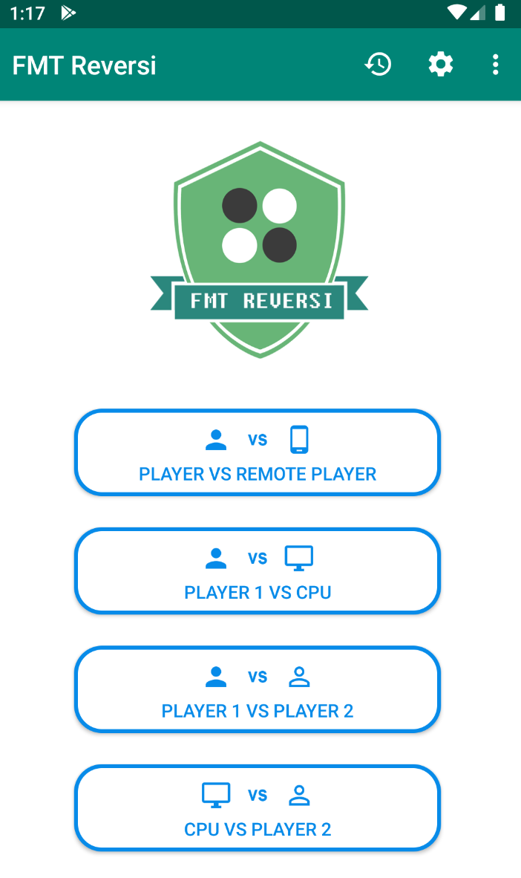
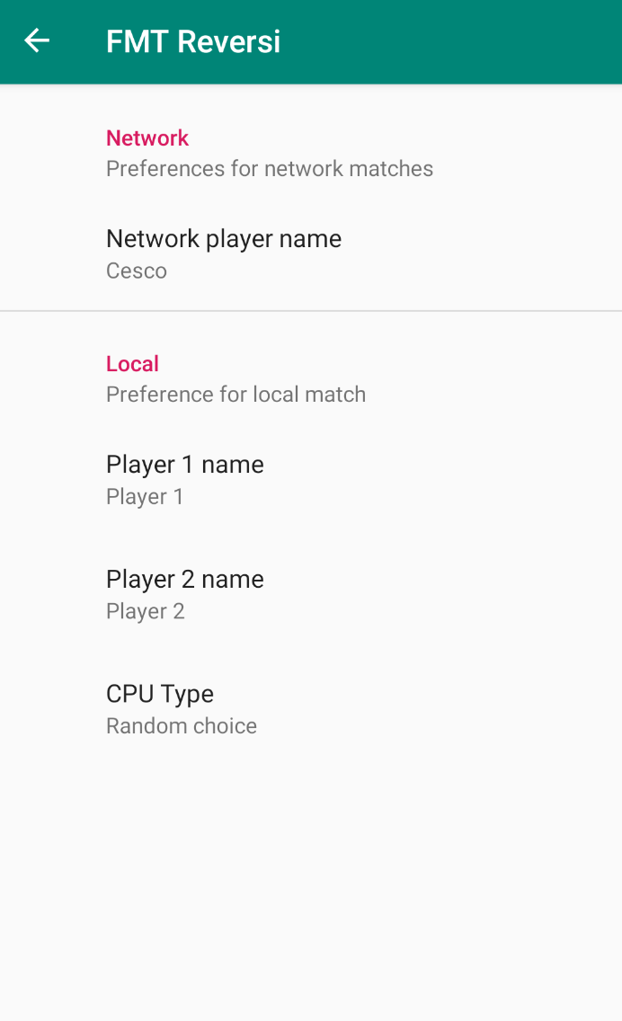
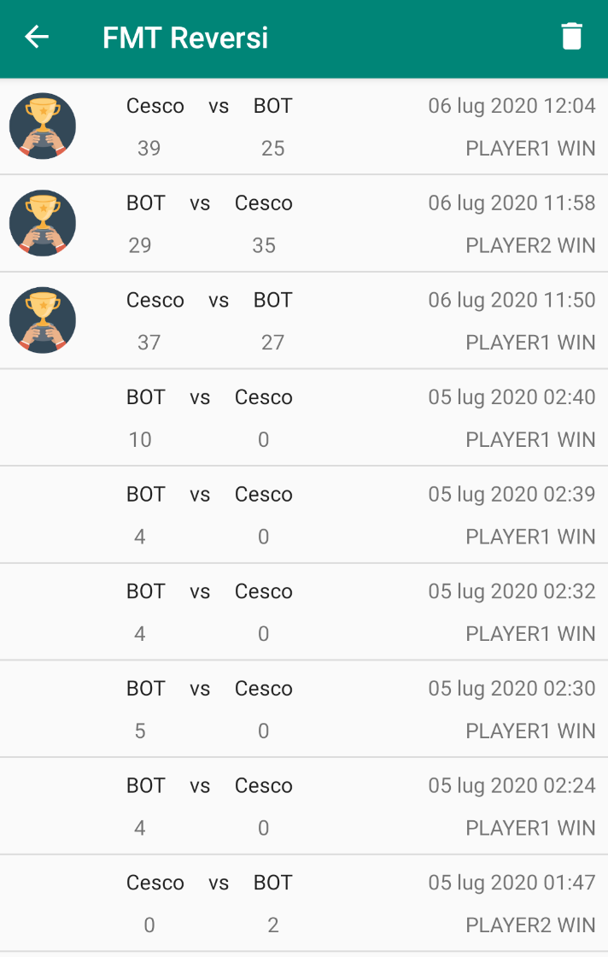
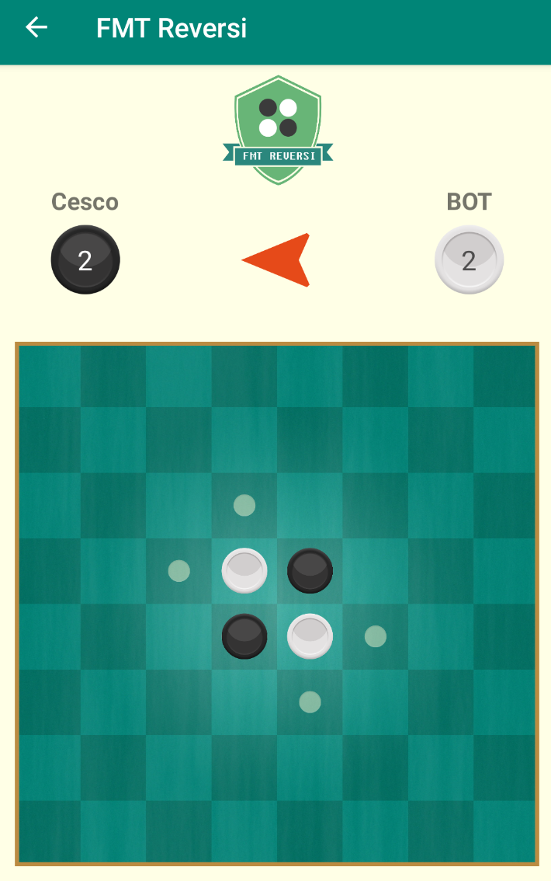
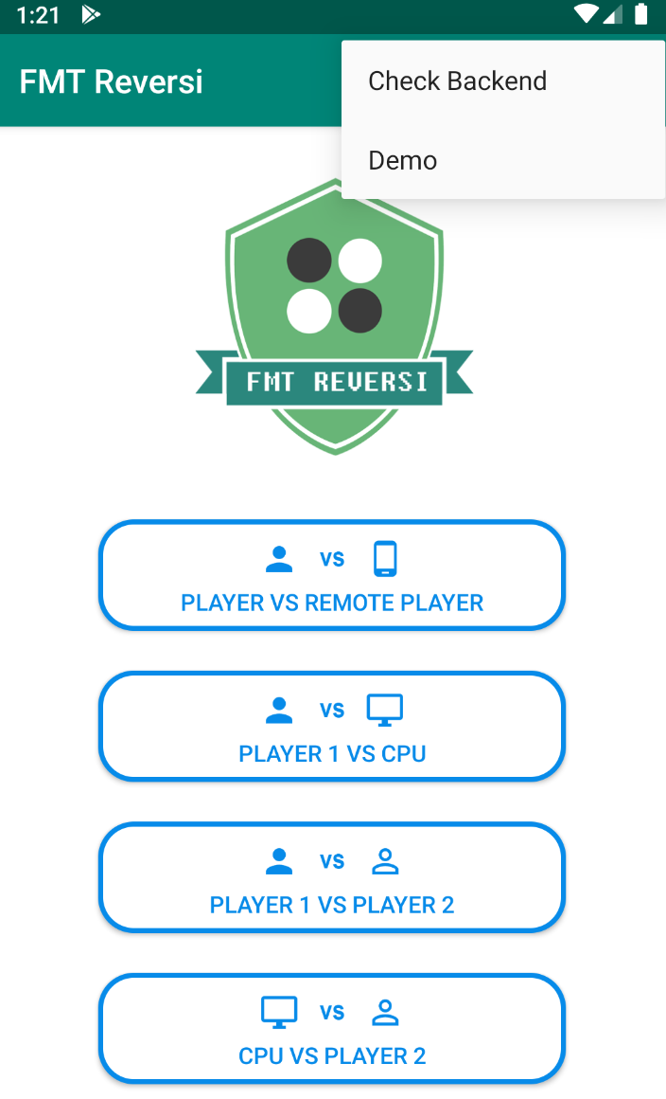
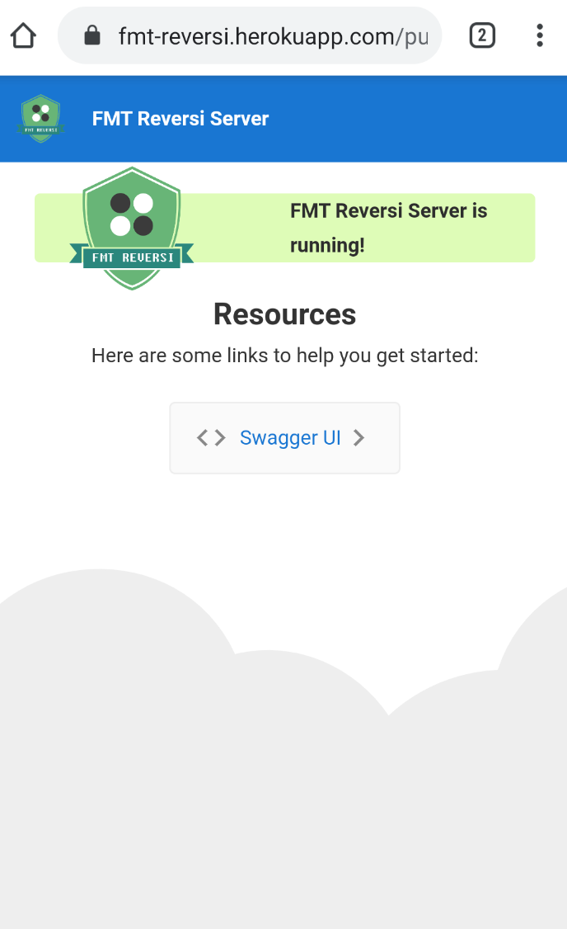
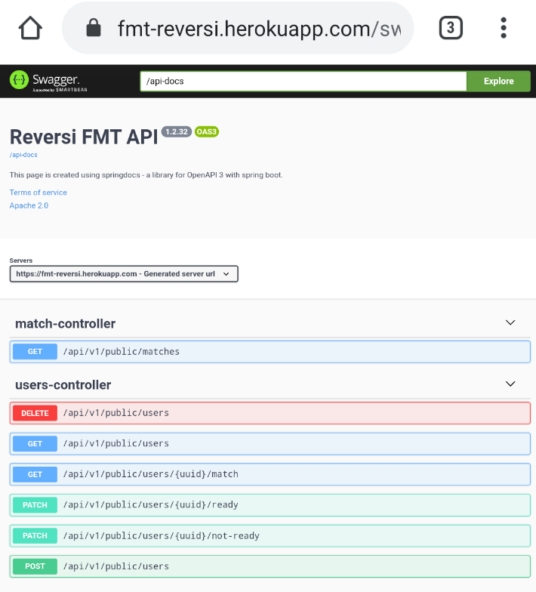
Navigation between fragments

Slide 17
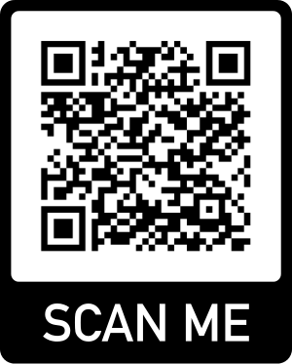
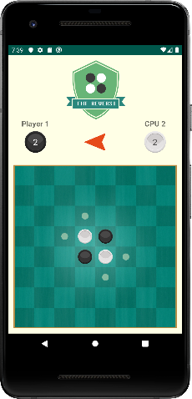
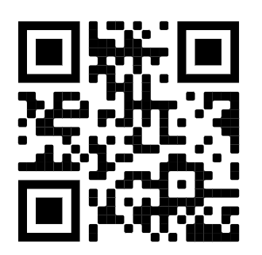
Demo
It’s time to play!
Android version available on Google Play Store
https://play.google.com/store/apps/details?id=it.fmt.games.reversi.android
Network match demo on https://youtu.be/RUfBwd1IXWg

Slide 18
Source code on GitHub
FMT Reversi Android source code on Github
FMT Reversi Backend source code on Github
FMT Reversi source code on Github

Slide 19
Conclusions
FMT Reversi can be improved:
Support for other platform (web)
Improved IA for CPU players
Google play game service
PS4 version cooming soon!
Any question?

Slide 20

Thanks!

